Slide 1

Team GOD
By: Sohal Patel, Emily Wantland, Scott Pettyjohn, Nathan Moran, Keegan Foulke, Matthew Jackson

Slide 2
Purpose/Problem
Too many clicks to reach content
Dead links
Poor organization
Outdated design
Limited functionality

Slide 3
Solution
Redesign website
Increase functionality with new/improved features
Decrease clicks to reach content
Eliminate dead links
Goal: Increase grant revenue

Slide 4
Main Goal & Our Users
We’re creating this site for the following users
Researcher
Student
Industry

Slide 5
Researcher
Create Profile
Can view content
Can Edit/delete user profile
Can RSVP for an event
Can apply for grants

Slide 6
Student
Can view content
Can create/Edit/delete user profile
Can RSVP for events
Industry
Can view content
Can create/Edit/delete user profile
Can RSVP for events

Slide 7
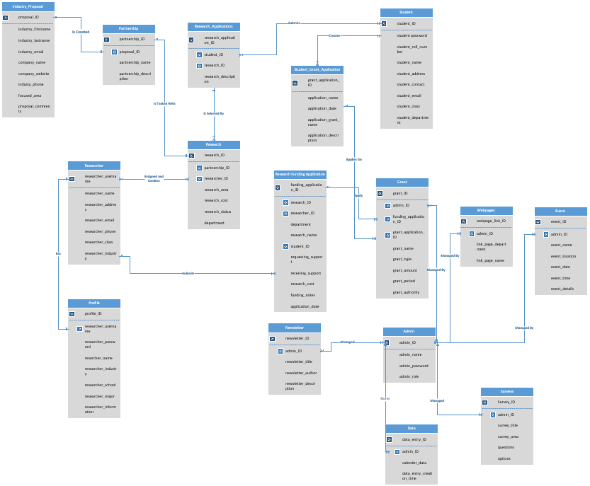
Full Schema

Slide 8
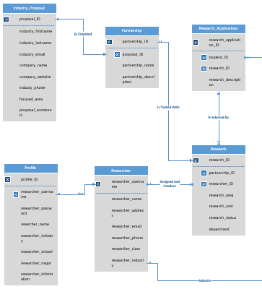
Research
Sub-Schema: Research

Slide 9
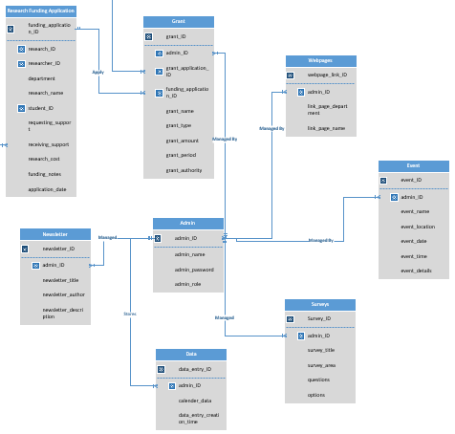
Sub-Schema: Admin

Slide 10
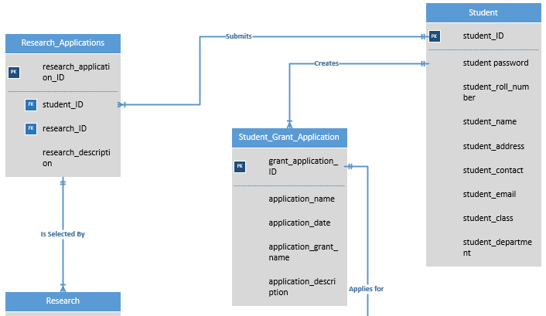
Sub-Schema: Student

Slide 11
Technologies/Tools
Project Management Software:
Asana
Wireframe Development:
Pencil
Development Platform:
Microsoft Visual Studio
Database Platform:
SQL Sever

Slide 12
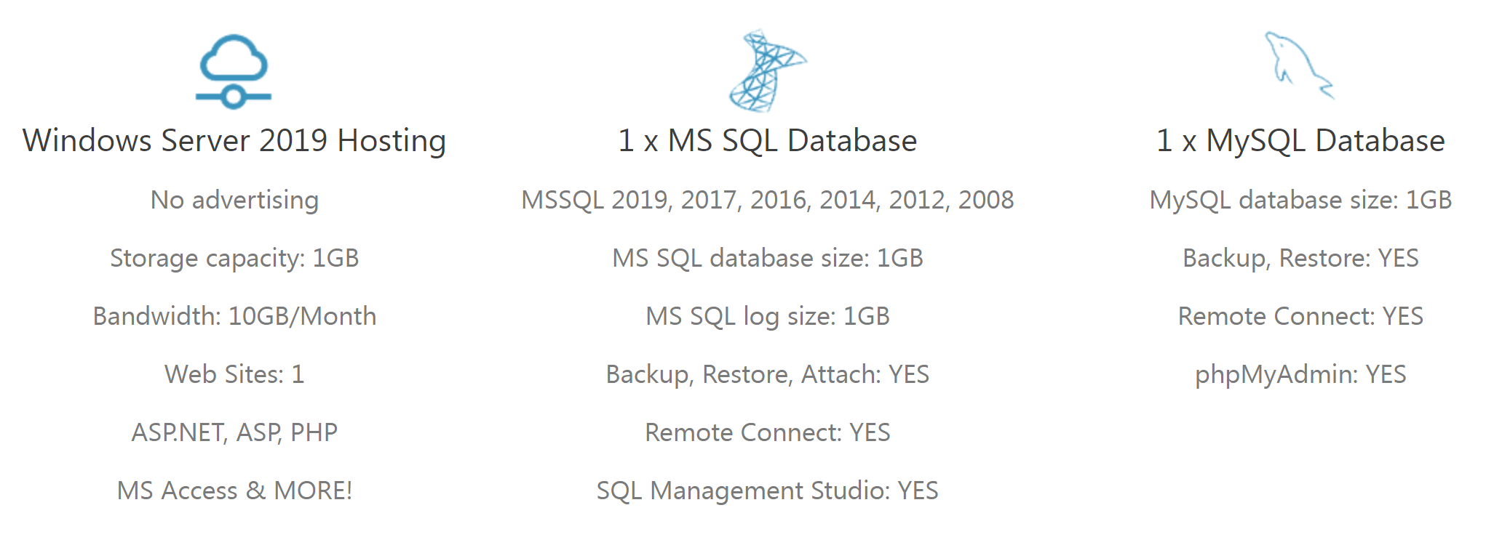
Hosting and Domain
SmarterASP.NET
Domain
www.ResearchAtUofL.com

Slide 13
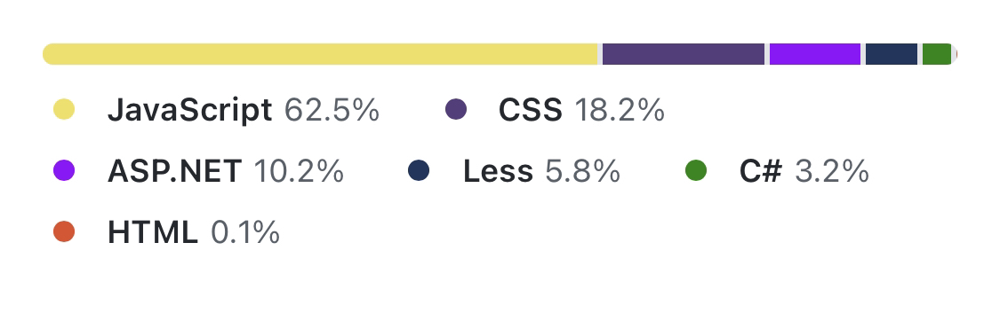
Languages Used

Slide 14
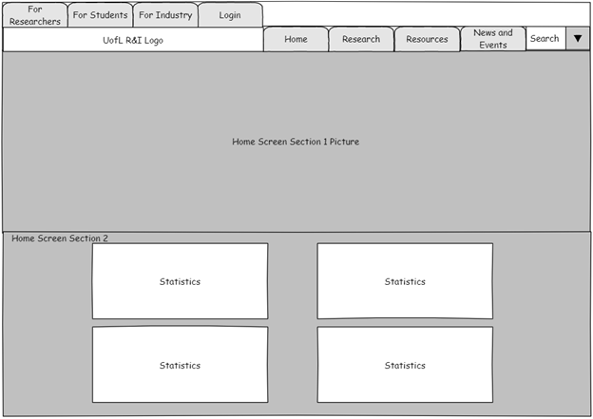
Wireframe – Home Screen
The landing page features 6 sections
Starts with infographics/statistics

Slide 15
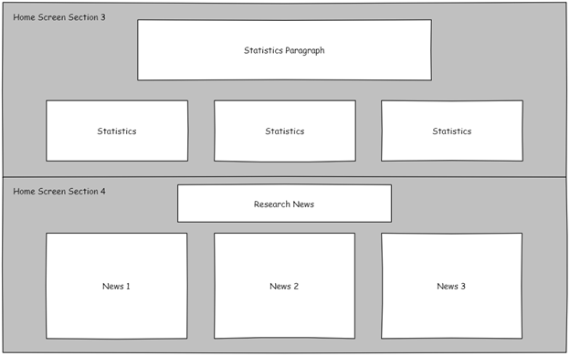
Wireframe – Home Screen
Section 3 – more statistics and infographics
Section 4 – Research specific news section

Slide 16
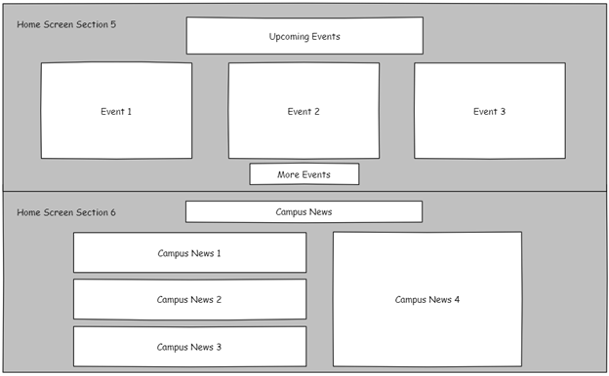
Wireframe – Home Screen
Section 5 – condensed events section
Section 6 – Campus specific news section

Slide 17
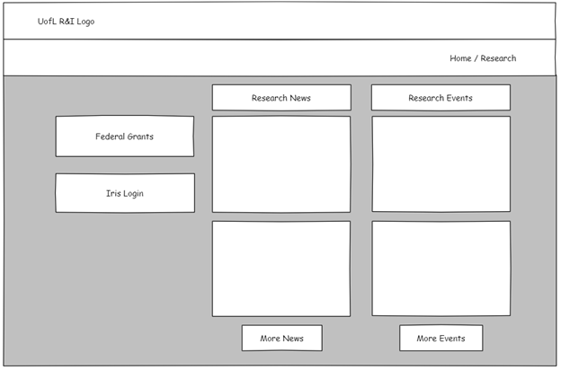
Wireframe – Research Home Page
Direct links to grants and Iris login
Condensed research specific news and events section
More button to view all News or Eventts
News 1
Event 1
News 2
Event 2

Slide 18
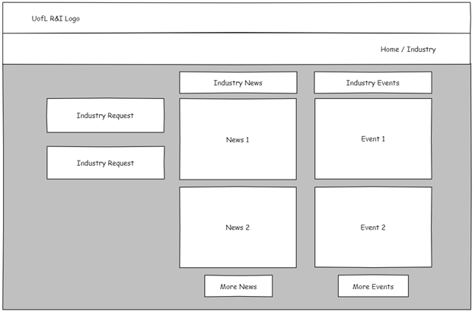
Wireframe – Industry Home Page

Slide 19
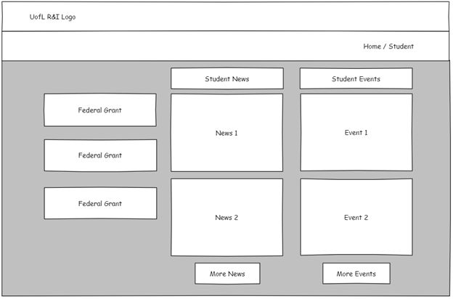
Wireframe – Student Home Page

Slide 20
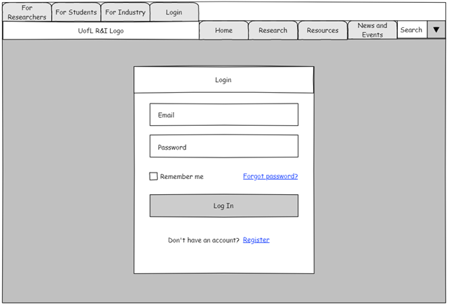
Wireframe – Login Page
Features links for password resets and registering (shown in prototype)

Slide 21
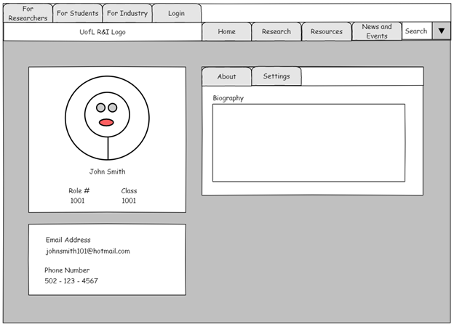
Wireframe – User Profile

Slide 22
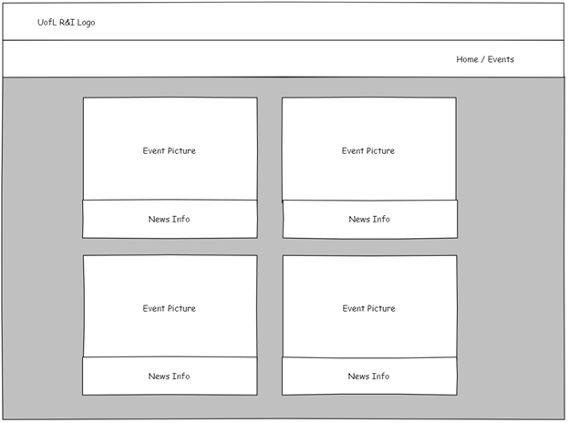
Wireframe – Events Page
Grid style layout for displaying events
News page is laid out similarly (shown in prototype)

Slide 23
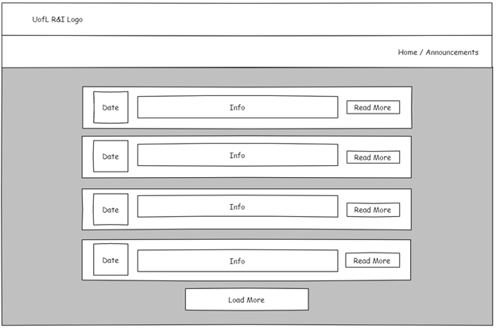
Wireframe – Announcements Page

Slide 24
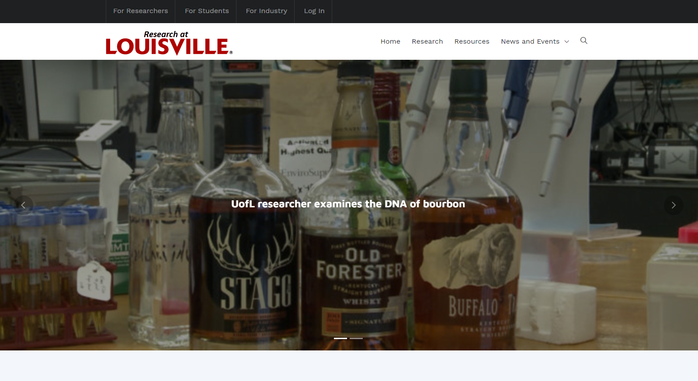
Home Section 1

Slide 25
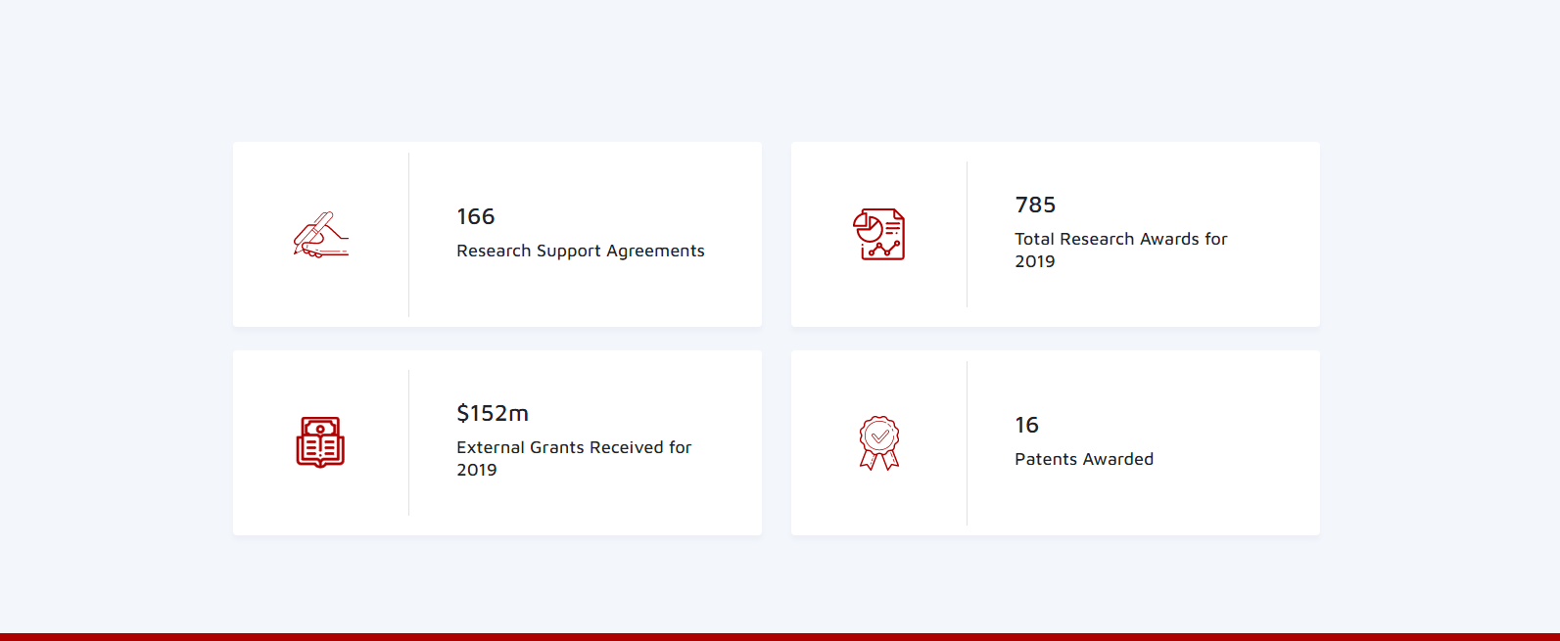
Home Section 2

Slide 26
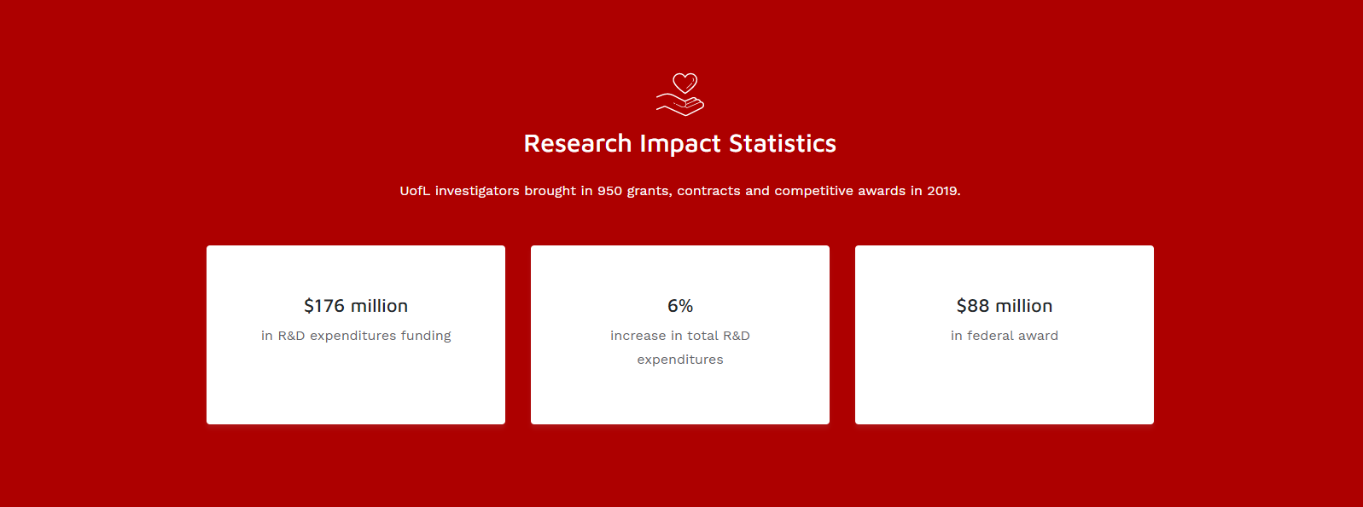
Home Section 3

Slide 27
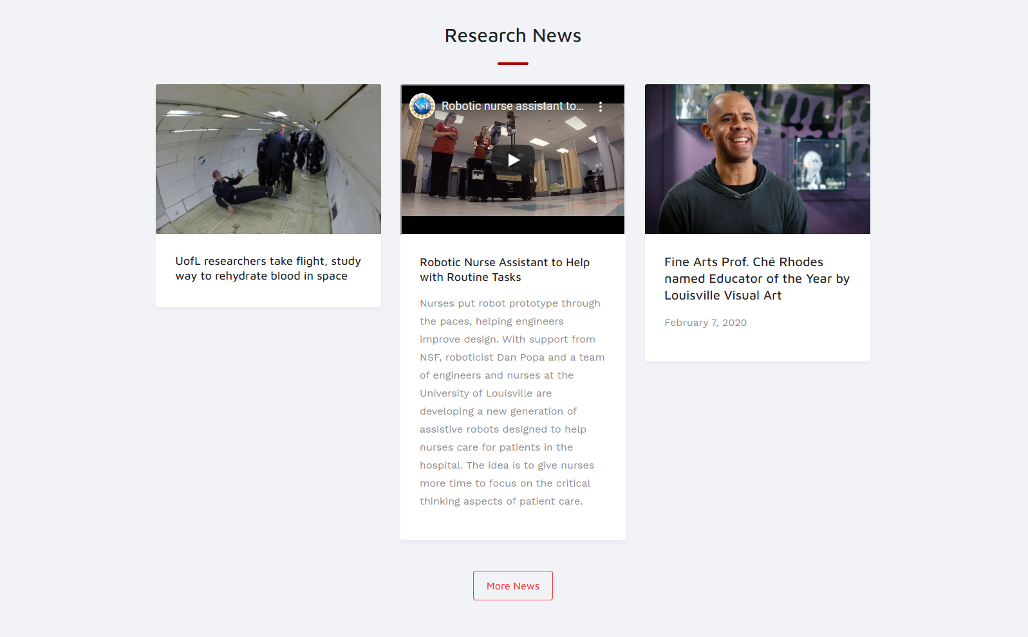
Home Section 4

Slide 28
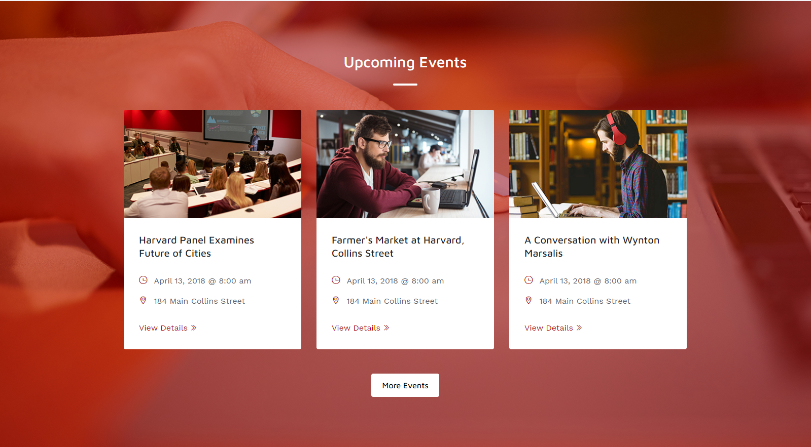
Home Section 5

Slide 29
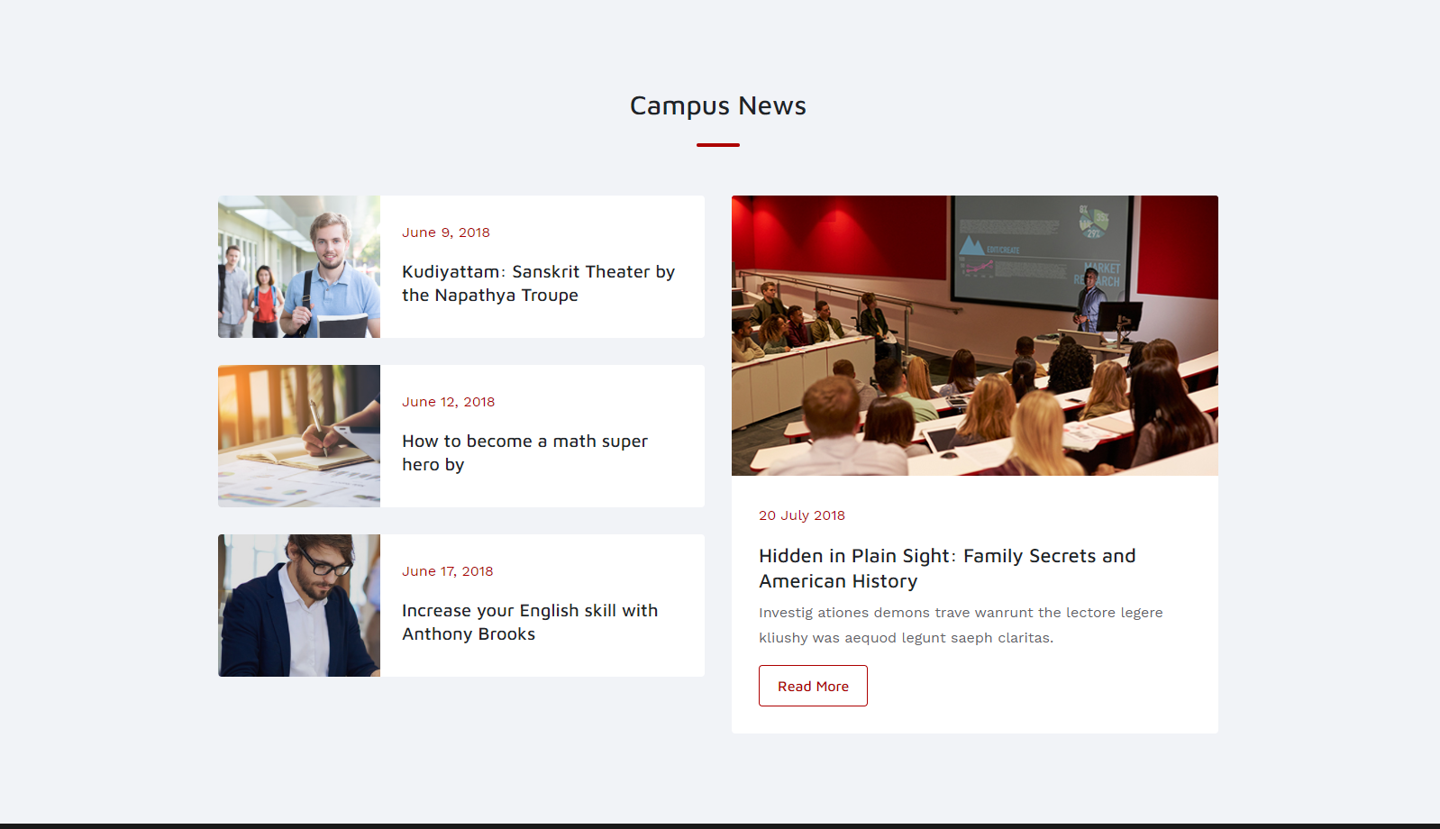
Home Section 6

Slide 30
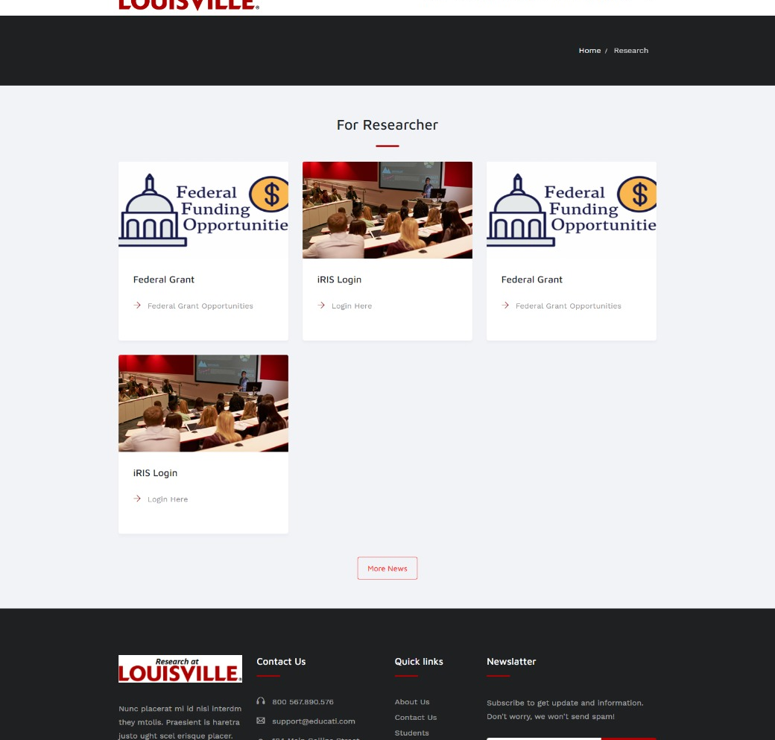
Researcher Page
Easily Managed through Admin Panel.
Only Design
Used Dummy Content
Can Easily Add/ Remove any section

Slide 31
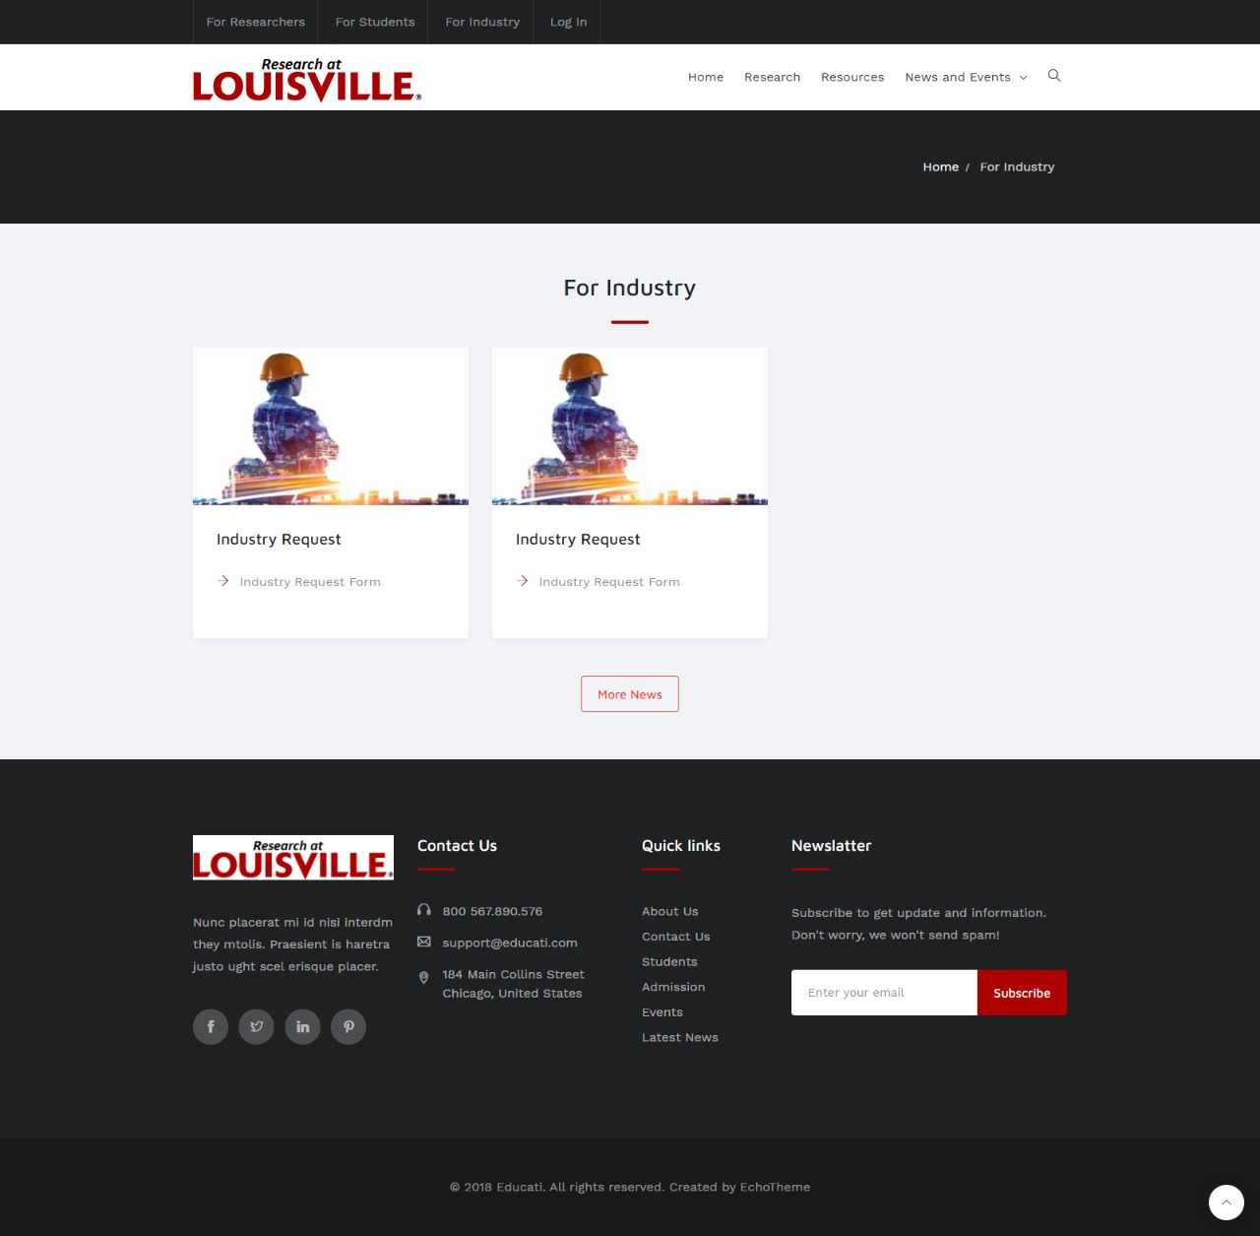
Industry Page
Easily Managed through Admin Panel.
Only Design
Used Dummy Content
Can Easily Add/ Remove any section

Slide 32
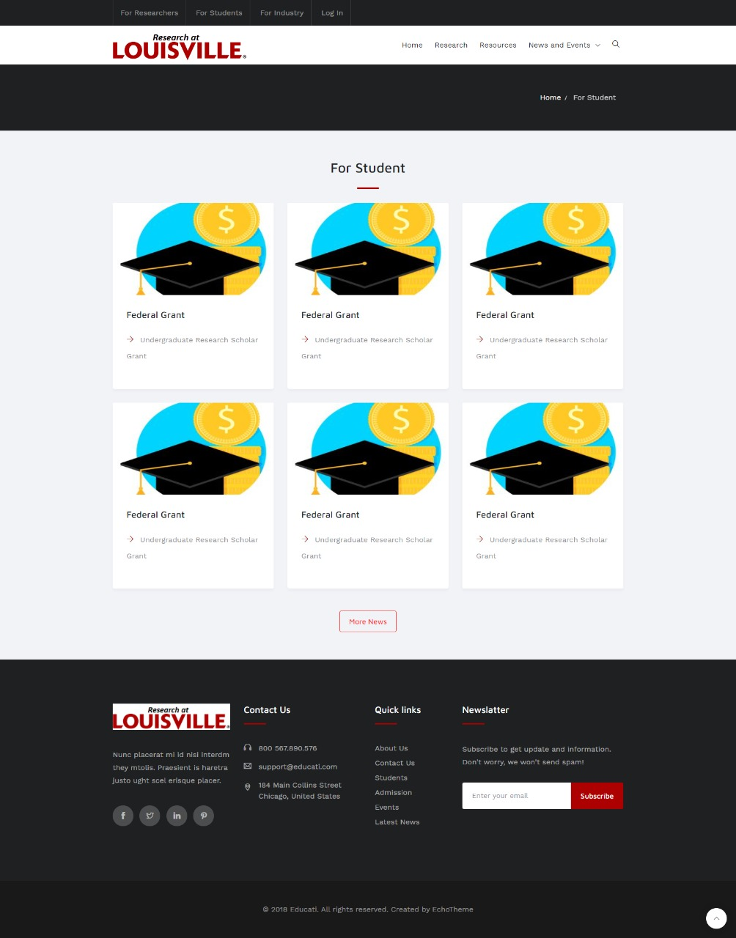
Student Page
Easily Managed through Admin Panel.
Only Design
Used Dummy Content
Can Easily Add/ Remove any section

Slide 33
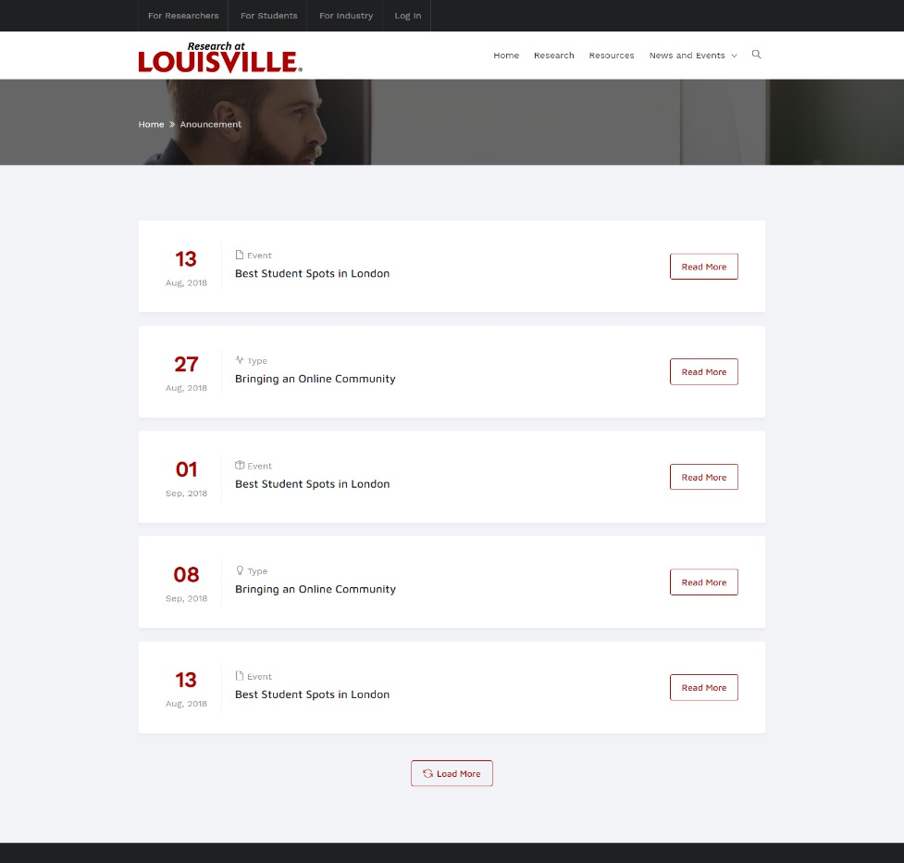
Announcement Page
Brings announcements to the view in a pleasing way
Modular design updated by date
Able to load more for looking into the future
Ordered by date

Slide 34
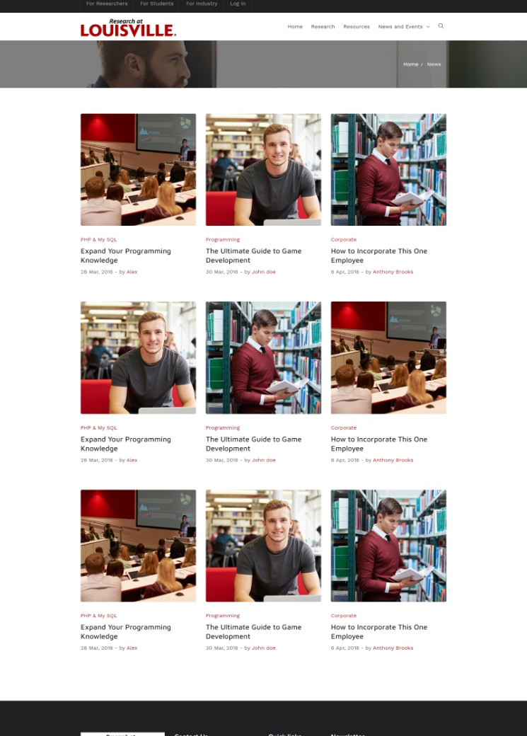
News Page
Like the announcements page
Ordered by date
Grid style offers customization
Clickable to expand info

Slide 35
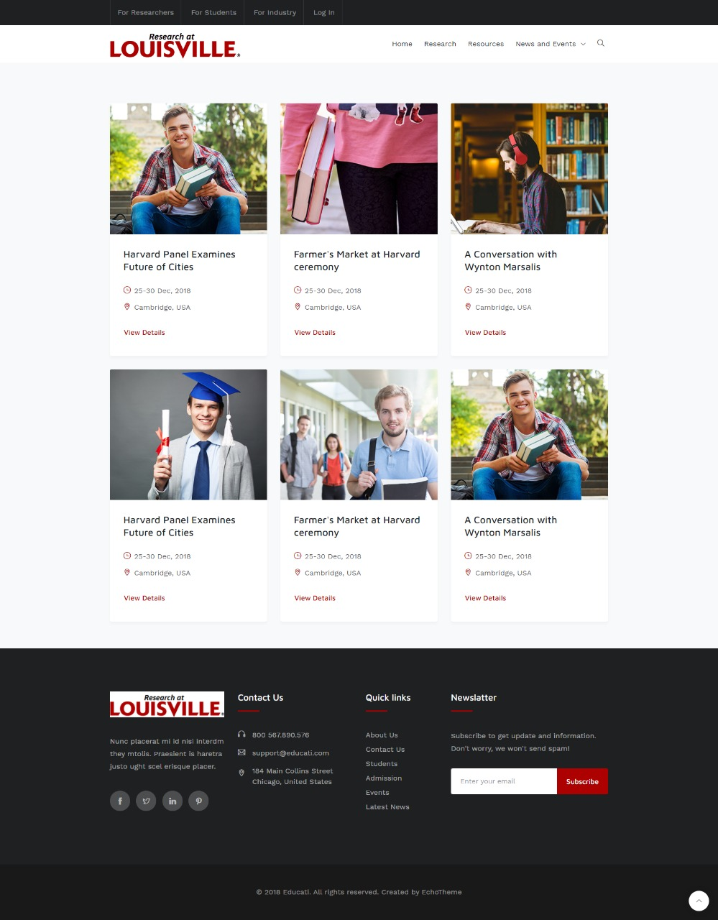
Event Page
Like previous two pages
Gives time and location
View Details gives more info
Grid style offers responsive design for multiple devices

Slide 36
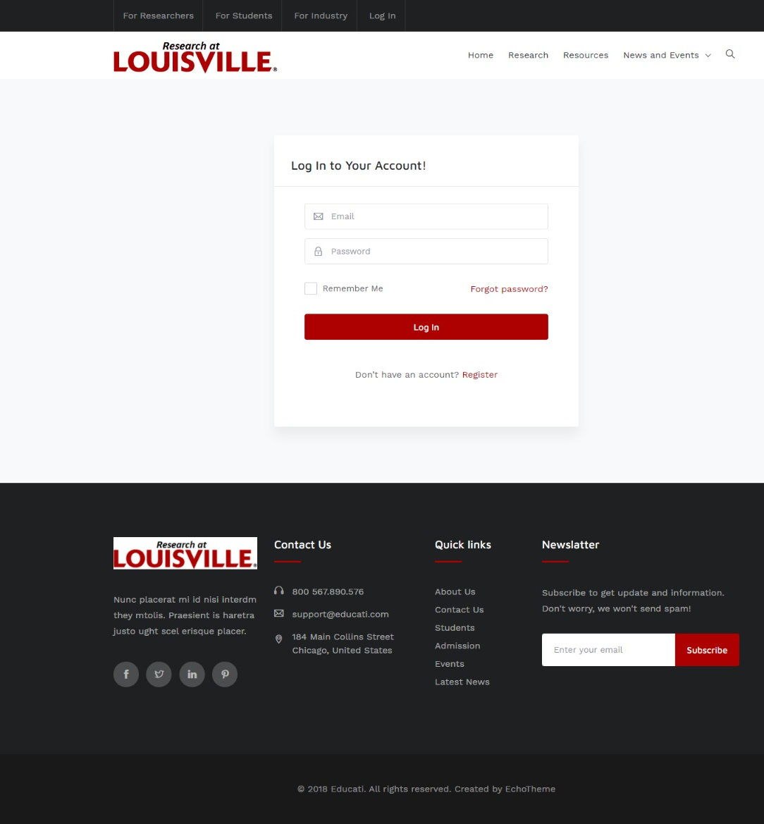
Login Page

Slide 37
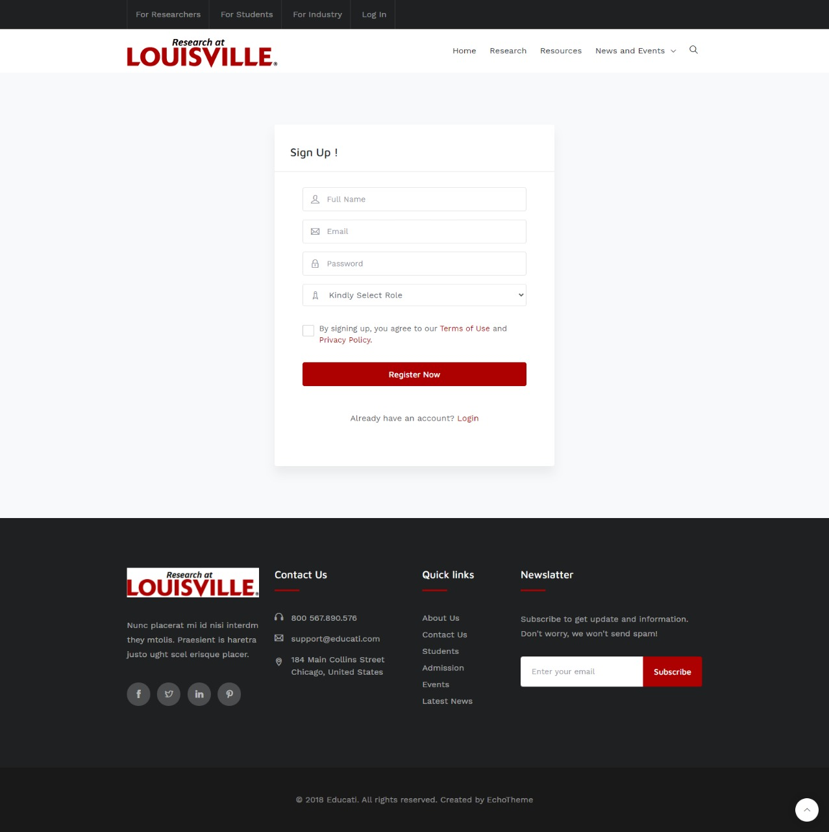
Signup Page

Slide 38

Reset Password Page

Slide 39
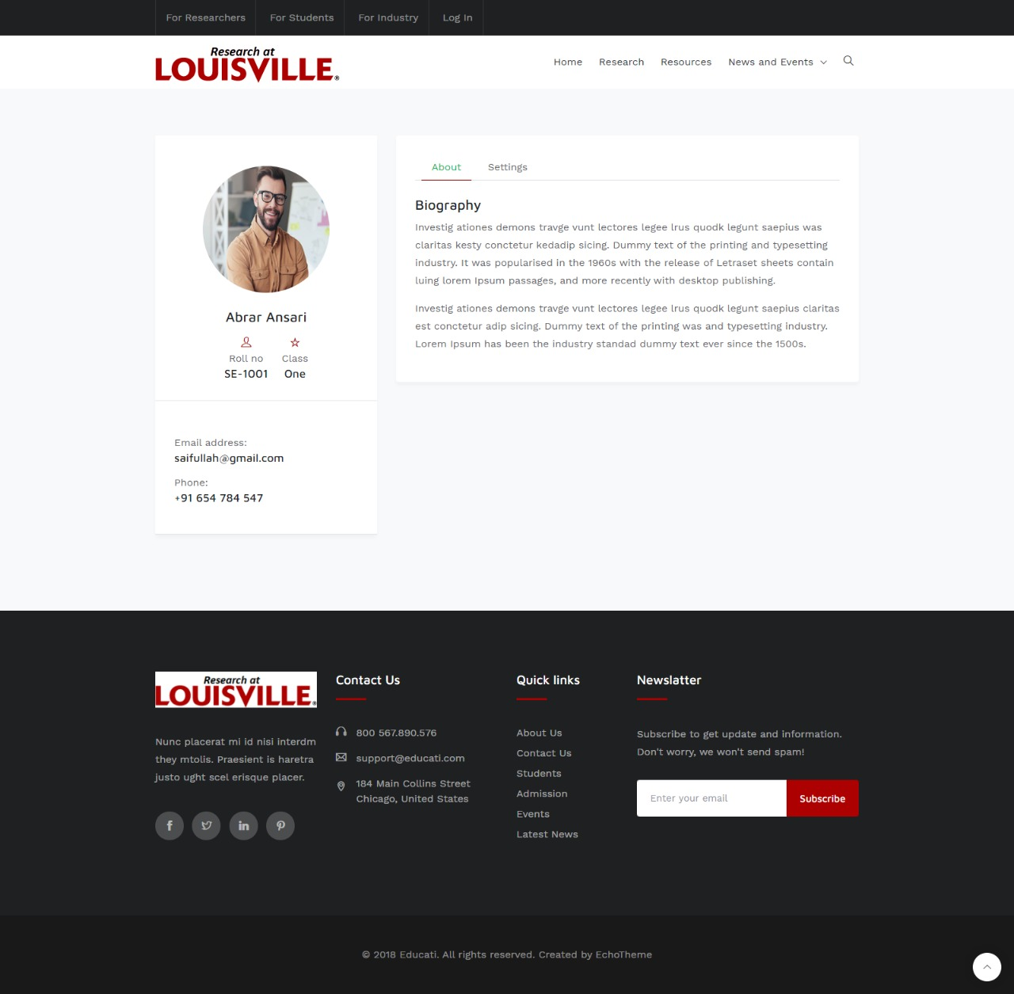
User profile Page

Slide 40
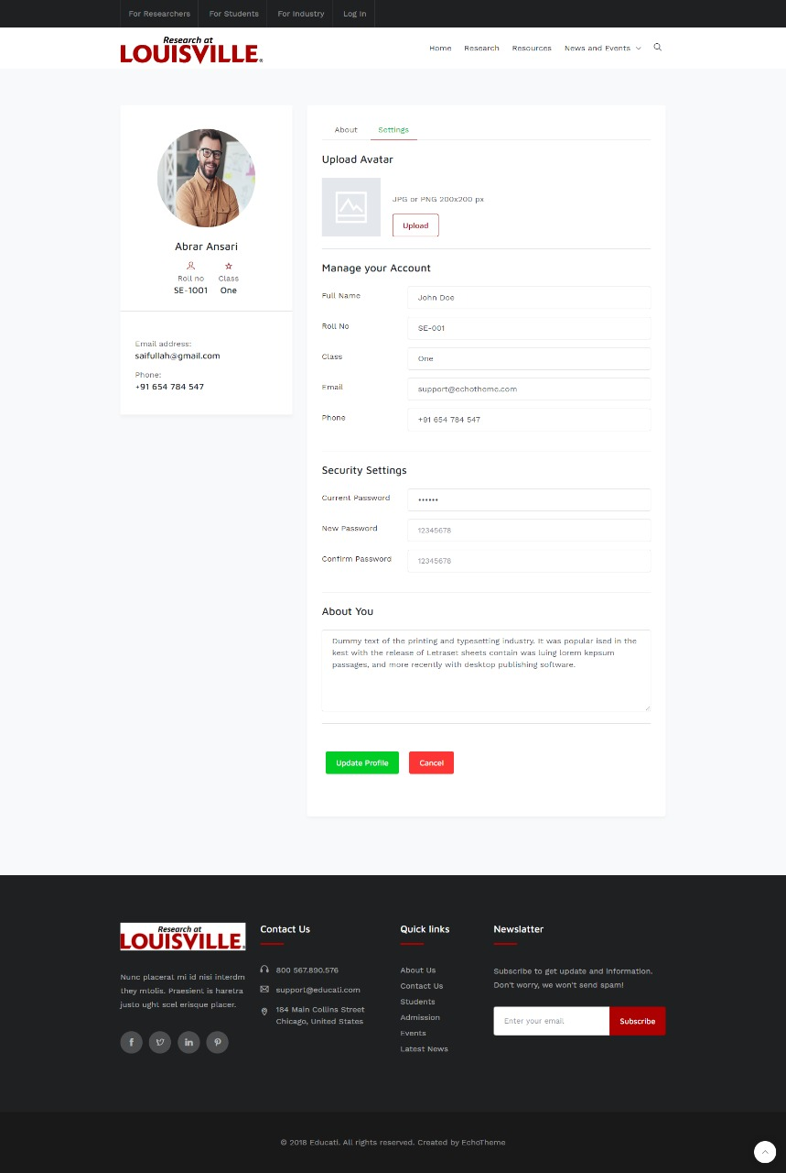
Profile Editing Page

Slide 41

Thank you

